Slide 1

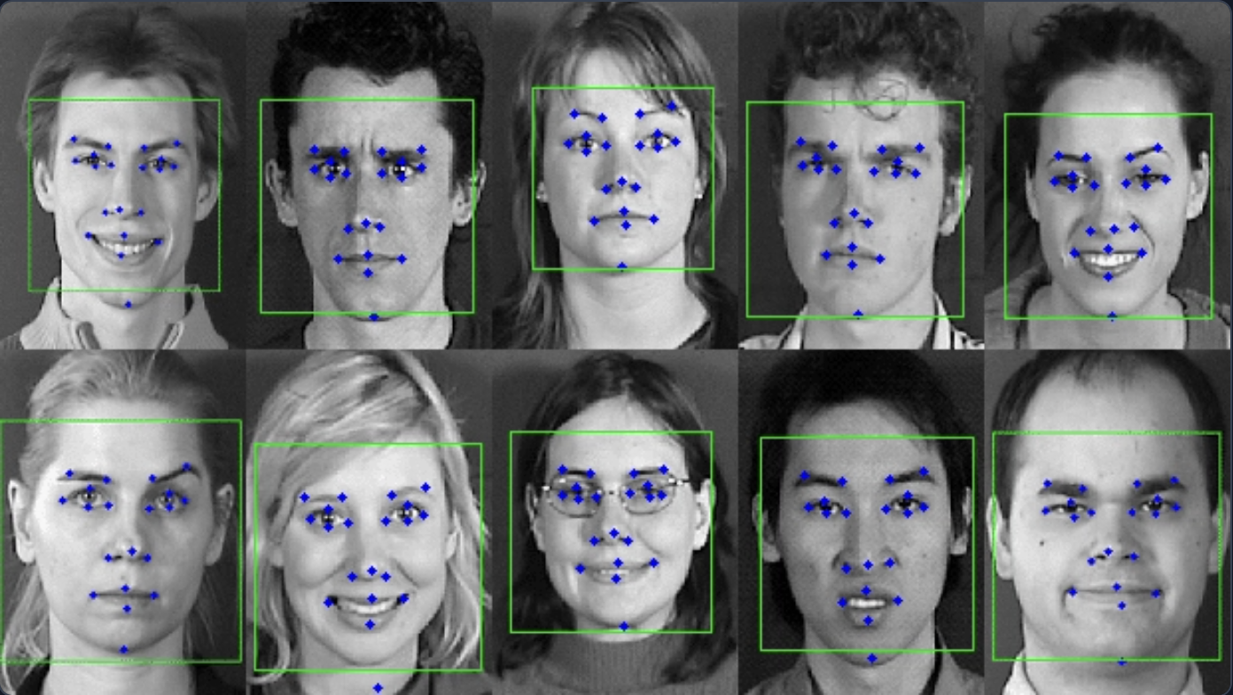
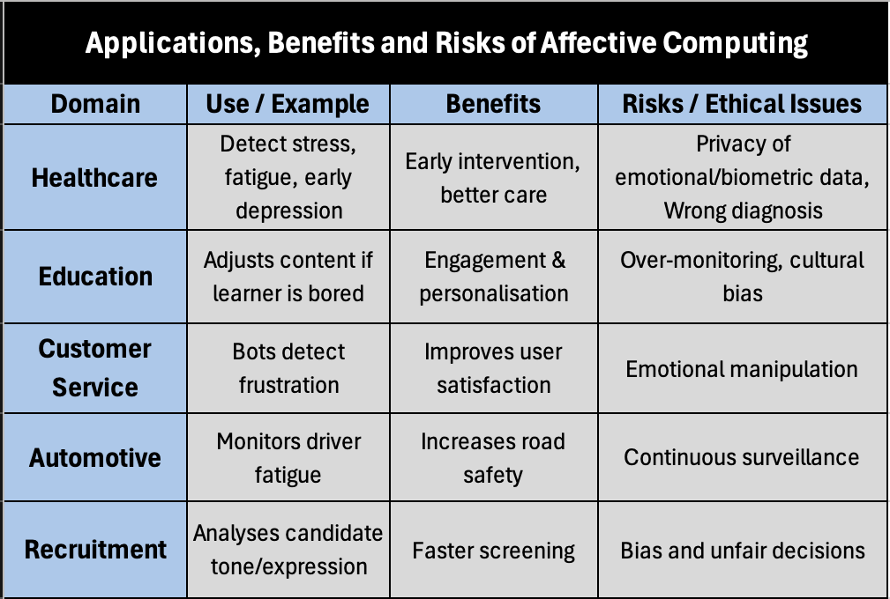
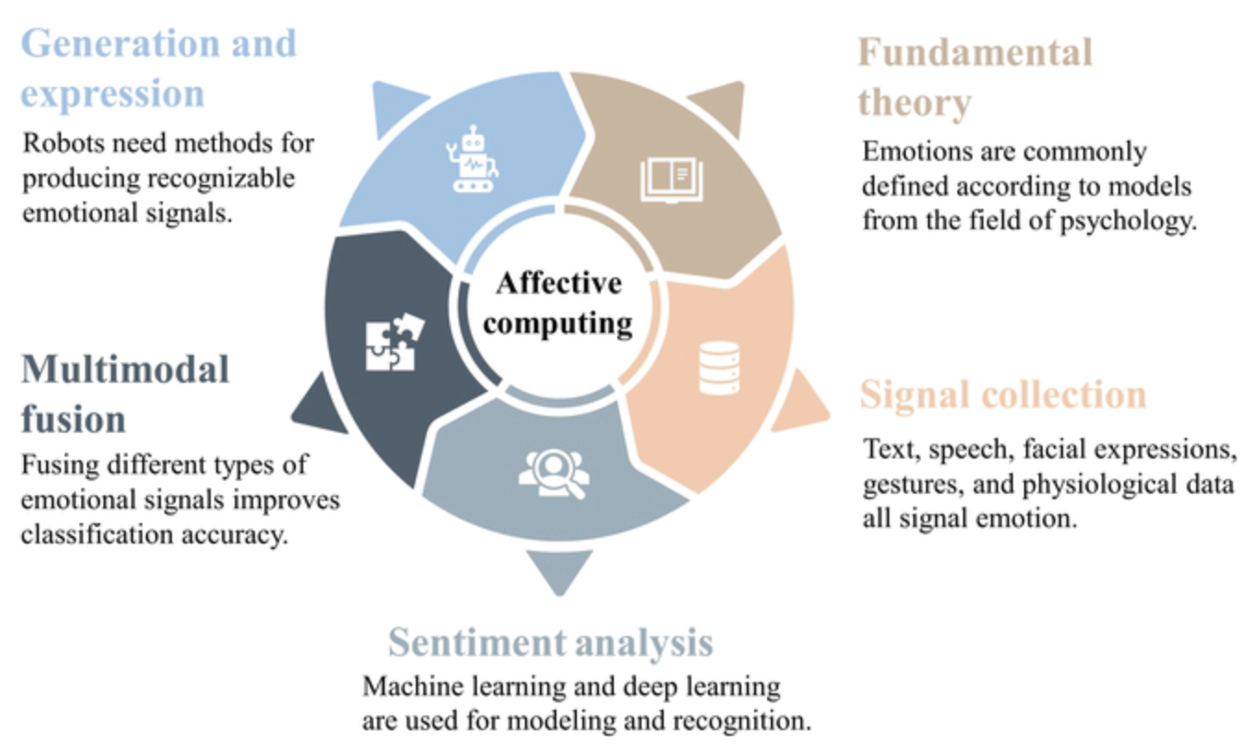
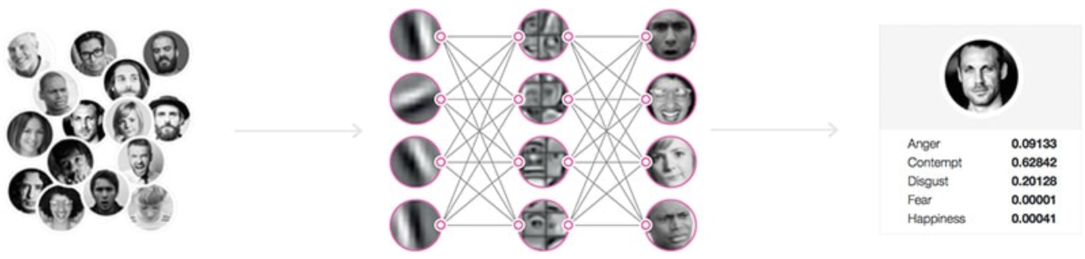
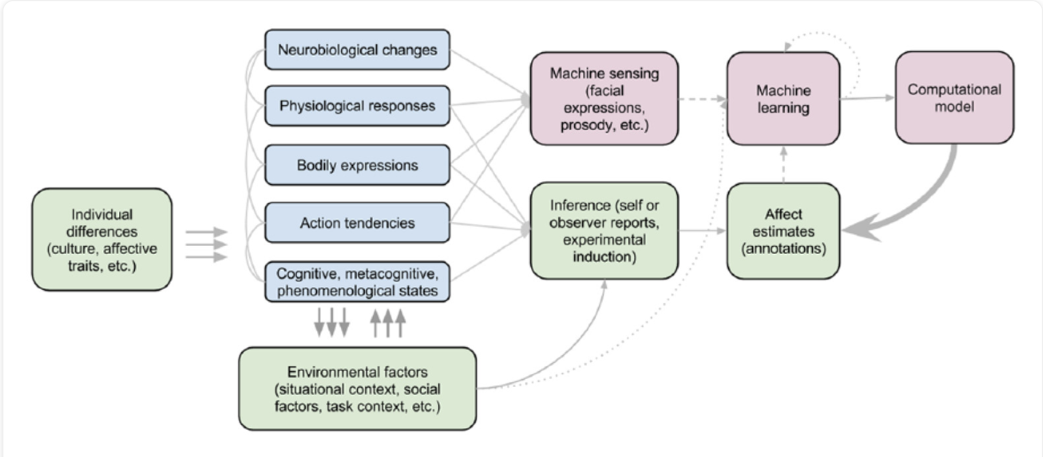
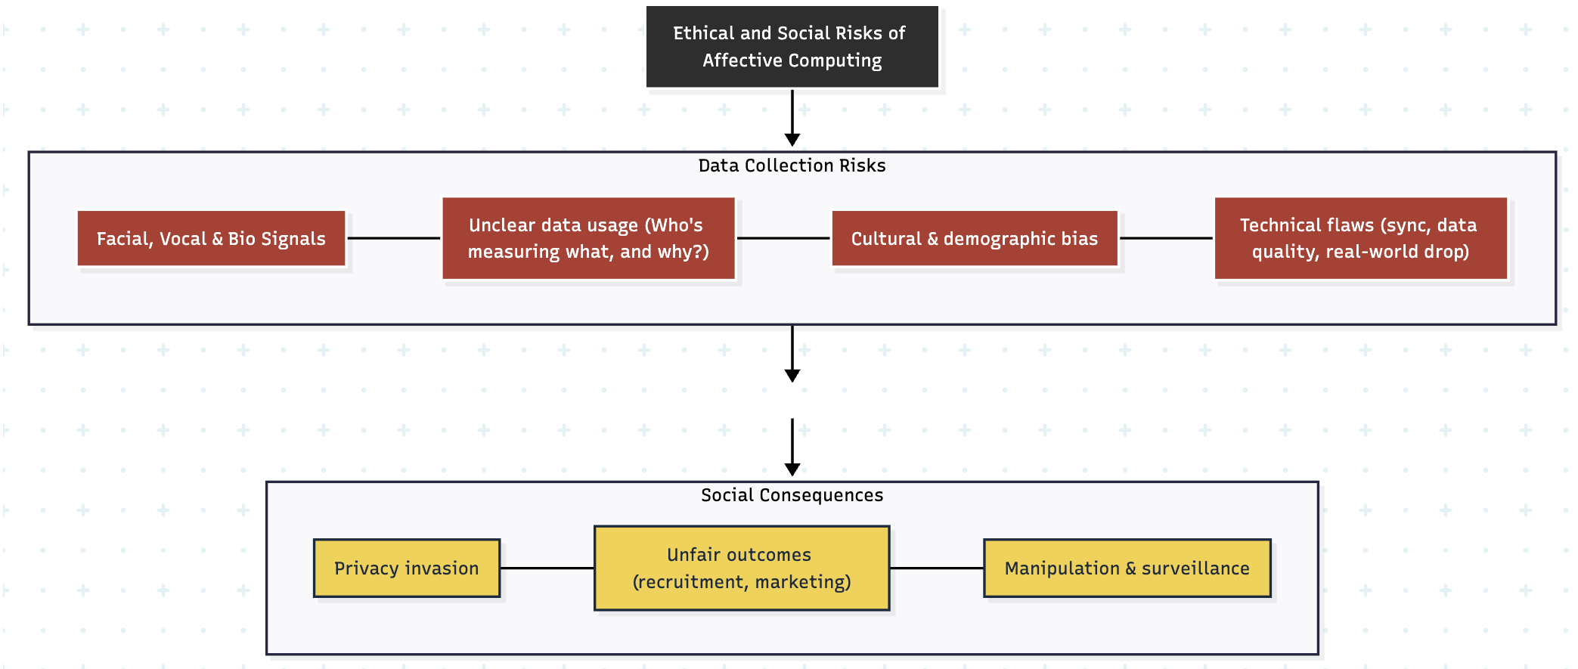
Affective Computing: Understanding the Emotional Side of Artificial Intelligence
Thiago Goncalves da Costa - 2022161
BSc of Science (Honours) in Computing and Information Technology – Fourth Year
What Is Affective Computing
And How It Is Used
In vehicles, driver-monitoring can increase safety. Overall, it offers personalisation and helps users and companies make better decisions. (Datacamp, 2024; AIMultiple, 2024).
Real-World Use Case
Affective Computing is a field of AI that helps machines to identify, comprehend, and react to human emotions. It combines cognitive science, psychology, and computer science to make human-computer interactions more natural and empathetic (ScienceDirect Topics, 2024).
Fig. 5. Facial Emotion Detection. Example of facial landmark tracking used in affective computing to identify emotional states through micro-expressions and facial geometry (AIMultiple, 2024).
Affectiva is a leader in emotion AI, and now part of Smart Eye (Affectiva, 2021). Its technology uses facial expression and voice to analyse human emotions in real-time. One of its main applications is in the automotive industry, helping to improve safety and driving experience.
In this system, cameras and microphones inside the car monitor the driver’s face and voice for signs of fatigue, distraction, or anger. By analysing the facial landmarks and expressions, the AI can alert the driver or make changes in the car environment to prevent accidents.
Fig. 3. Applications, Benefits and Risks of Affective Computing. Examples across domains showing key benefits and ethical risks (Datacamp, 2024; AIMultiple, 2024; Intelligent Computing, 2024).
Trained on millions of faces from over 80 countries, the deep-learning model detects emotional and cognitive states beyond simple gaze monitoring. Then initiates interventions like audio/visual alerts, cabin adjustments (cooler air, different music), or recommendations to stop and rest when it identifies a possible risk, such as the driver's head drooping, eyes closed, or continuous gazing away.
Fig. 1 Core Components of Affective Computing. Conceptual view showing fundamental theory, signal collection, sentiment analysis, multimodal fusion, generation & expression (Intelligent Computing, 2024).
Risks and Social Concerns: The greatest risk is keeping emotions private. Emotions are very sensitive and personal, plus users rarely know how this data is collected or used. (Intelligent Computing, 2024). Models trained on one group may completely misinterpret the emotions of another, leading to errors and unfair results due to cultural and demographic bias (Intelligent Computing, 2024). In recruitment, this could block opportunities; in marketing, it can enable manipulation (AIMultiple, 2024). Technically, even some of the latest multimodal systems still face problems like poor signal sync, uneven data quality, and weak real-world performance, increasing wrong decisions (Expert Systems with Applications, 2024; Intelligent Computing, 2024).
This technology collects physiological data such as heart rate or skin temperature and emotional signals like body language, voice tone, and facial expressions (Intelligent Computing, 2024). Machine learning and deep learning models are used to categorise these emotions and provide the right responses (Datacamp, 2024).
Affective Computing is applied across sectors such as healthcare, education, customer service, marketing, recruitment, and automotive safety (AIMultiple, 2024). It helps to identify stress, engagement, or satisfaction to improve decision-making and user experience.
Fig. 6. Affectiva’s Deep-Learning Process for Emotion Detection. Representation of how facial expressions are processed through neural networks to classify emotions such as anger, fear, and happiness (Affectiva, 2024).
Mitigations and Recommendations
To ensure safe and fair use of emotional data, Affective systems should follow key ethical principles:
Consent & Transparency: Users must know what emotional data is collected and why.
Data Minimisation: Only important data must be stored or processed.
Bias Testing: Models should be tested often across diverse groups.
Human Oversight: Human must stay involved in sensitive decisions.
These reduce privacy risks, promote fairness and build trust.
Fig. 2 Conceptual and Computational Foundation of Affective Computing. The framework shows how emotional states are captured and processed through sensing, inference, and computational modelling (SAGE Journals, 2017).
Fig. 4. Ethical and Social Risks of Affective Computing. Illustration of how data collection issues like unclear use, bias, and technical flaws can lead to privacy invasion, unfair outcomes, and manipulation if not properly managed.
Ethical and Social Impact
What this means in practice: To balance these opportunities and challenges, it’s essential that affective systems follow ethical principles such as consent, data minimisation, clear explanations, bias testing, and human oversight. Despite the social benefits like safety and accessibility, without these protections, good intentions can easily turn into surveillance and unfair outcomes. (ScienceDirect Topics, 2024; Intelligent Computing, 2024; AIMultiple, 2024).
Positive Side: Affective Computing can help if it is used carefully. In healthcare, physiological data together with voice and facial expressions can detect stress, fatigue or early depression to act faster. In education, systems can adapt the content or pace when learners appear bored or distracted. In customer service, bots that sense frustration can change tone or transfer the chat to a human.
References
Abid Ali Awan (2023). What is Affective Computing? [online] Datacamp.com. Available at: https://www.datacamp.com/blog/what-is-affective-computing.
Affectiva (2017). Home - Affectiva. [online] Affectiva. Available at: https://www.affectiva.com/.
Arslan, E. (2025). Affective Computing: In-Depth Guide to Emotion AI. [online] research.aimultiple.com. Available at: https://research.aimultiple.com/affective-computing/.
D’Mello, S., Kappas, A. and Gratch, J. (2017). The Affective Computing Approach to Affect Measurement. Emotion Review, 10(2), pp.174–183. doi:https://doi.org/10.1177/1754073917696583.
Hussein, Das, B. and Das, R. (2024). A systematic review of trimodal affective computing approaches: Text, audio, and visual integration in emotion recognition and sentiment analysis. Expert Systems with Applications, pp.124852–124852. doi:https://doi.org/10.1016/j.eswa.2024.124852.
Pei, G., Li, H., Lu, Y., Wang, Y., Hua, S. and Li, T. (2024). Affective Computing: Recent Advances, Challenges, and Future Trends. Intelligent Computing, 3. doi:https://doi.org/10.34133/icomputing.0076.
Schuller, B.W., Hu, B., Singh, J. and Hudlická, E. (2017). Affective Computing - an overview | ScienceDirect Topics. [online] Sciencedirect.com. Available at: https://www.sciencedirect.com/topics/computer-science/affective-computing.
Our Dedication. Your Journey.
www.cct.ie

